Slide 1
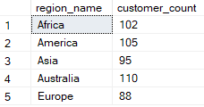

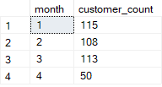
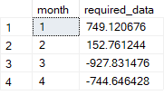

Data Bank
Transaction Analysis
1
2
Unique count and total amount for each transaction type
Number of Customers allocated to each region
3
4
5
Average days for customers to reallocated to a different node
Number of customers make more than 1 deposit and either 1 purchase or 1 withdrawal in a single month
Required data for reward customer by increasing data allocation based off interest on daily basis

